Slide 1

BANK MANAGEMENT PROJECT

Slide 2
INTRODUCTION
The Bank Management System is a software project developed in the C programming language. The system aims to provide basic banking functionalities such as account creation, user login, and exit options to users.

Slide 3
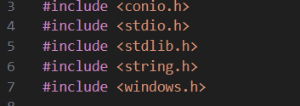

Slide 4
2. SCOPE
The scope of the Bank Management System project encompasses(s) the following functionalities:
Account Creation: Users can create new bank accounts by providing necessary details.
User Login: Existing users can log in using their username and password.
System Exit: Users can exit the system at any point.

Slide 5
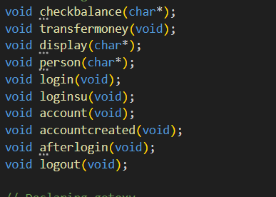

Slide 6
3. IMPLEMENTATION
4.1 Account Creation
The account creation process involves collecting user details, validating input, and storing information securely. The program utilizes data structures and file handling for persistent storage.
4.2 User Login
User login functionality requires username and password verification. Passwords are securely stored using appropriate encryption techniques, and access is granted upon successful verification.
4.3 System Exit
The program provides an option for users to gracefully exit the system, ensuring proper resource management and data integrity.

Slide 7
CONCLUSION
The Bank Management System project in C language successfully implements the desired functionalities, providing users with a basic yet effective banking solution. The modular design and user-friendly interface contribute to the project's overall success.

Slide 8
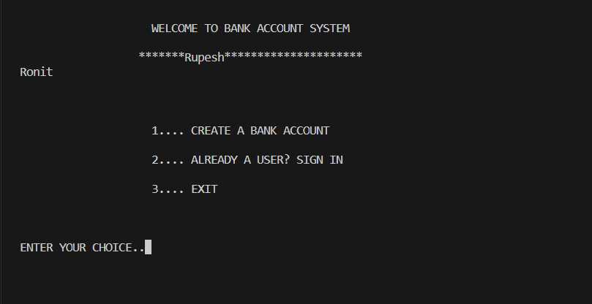
FINAL OUTPUT

Slide 9
APPLICATIONS
Coding Practice and Skill Development:
Individuals looking to enhance their C programming skills can use your project as a practical coding exercise.
Training and Workshops:
The project can be used in programming workshops and training sessions to teach participants about building simple software applications using C.
Learning Security Concepts:
The login system in your project provides a practical example for learning and understanding concepts related to user authentication and password security.

Slide 10
Educational Purposes: The project serves as an excellent educational tool for students learning C programming language and software development. It can be used in programming courses to demonstrate file handling, user input validation, and basic menu-driven interfaces. Small and Medium-sized Banks: Your Bank Management System can be deployed in small and medium-sized banks to automate and streamline their account creation and login processes.

Slide 11

BY –RUPESH (22BTC35156)
BANK MANAGEMENT PROJECT

